Slide 1
Equity Market: VC, PE, and Global Equity Markets
Dr. Sarveshwar Kumar Inani
sarveshwarinani@wilp.bits-pilani.ac.in

Slide 2
Agenda:
Venture Capital (VC) Funds
Private Equity (PE) Funds
Public Equity
Institutional Use of Stock Markets
Globalization of Stock Markets
Source: The content in this ppt is borrowed from the book “Financial Markets and Institutions” by Jeff Madura (Cengage).

Slide 3
Private Equity (PE)
Explain Debt vs Equity. Providers of equity become part owners of the firm, whereas lenders that offer debt financing to a firm do not become owners.
Equity can help a firm finance its business expansion without any interest burden.
Explain Private Equity vs Public Equity
When a company is private and not listed on any exchange, it can not invite public to invest in it. Hence, the equity held in such company by founders and investors is called private equity.

Slide 4
PE Financing by Venture Capital (VC) Funds
Venture capital is a form of private equity financing where the investment focus is startups, early-stage and emerging companies (that have high growth potential). Venture capital firms provide funding to these startups, hoping for significant returns based on the companies' innovative ideas and business models.
Private firms that need a large equity investment but are not in a position to go public may attempt to obtain funding from a venture capital (VC) fund.
A VC fund receives money from wealthy investors and from pension funds that are willing to maintain the investment for a long-term period, such as 5 or 10 years. These investors are not allowed to withdraw their money before a specified deadline.
A VC fund uses the money that it receives from its investors to purchase minority stakes in selected private companies that need funding.
The VC market brings together the private businesses that need equity funding and the VC funds that can provide funding.

Slide 5
Venture Capital (VC) Funds
Prominent technology firms that relied on VC funding before conducting an IPO include Apple, Facebook, Microsoft, Oracle, and Twitter.
Venture capital conferences allow for interactions between firms that need private equity funding and VC funds that have funds to invest. If a VC fund identifies a proposal that it believes has much potential, it may arrange a meeting with the firm’s owners and request more detailed information.
Most proposals are rejected, however, because VC funds recognize that the majority of new businesses ultimately fail.

Slide 6
Venture Capital (VC) Funds
The fund sets out clear requirements that the business must meet to receive the funding, such as providing detailed periodic financial reports.
To ensure that the company is following a promising path, the VC fund managers may serve as advisers to the business. They may also insist on having a seat on the board of directors so that they can influence the firm’s future progress.
Example: Facebook, founded in 2004, secured early-stage funding from Peter Thiel and Accel Partners and other VC firms. These investments allowed Facebook to grow and eventually went public in 2012, resulting in significant returns for early investors like Thiel.

Slide 7
Exit by Venture Capital (VC) Funds
A VC fund typically plans to exit from its original investment in about four to seven years. One common exit strategy is to sell the equity stake to the public after the business engages in a public stock offering.
Alternatively, the VC fund may cash out if the company is acquired by another firm: Such an acquirer purchases all of the company’s shares, including those owned by the VC fund.
Thus, the VC fund commonly serves as a bridge for financing the business until it either goes public or is acquired.
Example: Sequoia Capital is a VC fund that has provided VC financing to many firms in the tech sector during their early stages of development, including Apple, Google, Oracle, WhatsApp, and Yahoo. In February 2014, WhatsApp was acquired by Facebook, and Sequoia Capital earned more than $3 billion from its investment. Ultimately, Sequoia’s return may have been more than 50 times its investment.

Slide 8
Performance of VC Funds
Performance Variation: VC fund performance fluctuates over time, influenced by market conditions.
Valuation Impact: Low stock prices lead to lower valuations of private companies, allowing VC funds to invest more wisely.
Investor Influence: The amount of funds raised by VC funds affects their investment decisions and potential returns.
Overvaluation Risk: In periods of high valuations and abundant funding, VC funds may overpay for investments due to competition.
Focus and Efficiency: With limited funds, VC funds can focus on the most promising investments, reducing the risk of overpaying.

Slide 9
Top VC Funds
Source
Tiger Global Management, USA (AUM: $58 billion): Invested in Facebook, Uber, OpenAI.
Sequoia Capital, USA (AUM: $55.7 billion): Famous investments include Apple, Cisco, Google, Instagram, LinkedIn, PayPal, WhatsApp, and Zoom.
Andreessen Horowitz, USA (AUM $52 Billion): Known for investing in tech giants like Facebook, Twitter, and Airbnb.
Legend Capital, China (AUM $44 Billion): Invested in Xiaomi, Kingsoft.
Accel, USA (AUM: $19.1B): Backed companies like Facebook, Dropbox, and Spotify.
Top VC funds in India (Open and show investments)

Slide 10
Private Equity Funds
Private companies that need private equity may also consider private equity funds, which receive investments from institutional investors (such as pension funds and insurance companies) and invest the funds in businesses.
With PE funds, some restrictions are placed on investments like minimum $1 million investment or lock-in period of 5-10 years.
Unlike VC funds, private equity funds purchase a majority stake in a business or even the entire company.
Consequently, their investment in a business is usually much larger than the typical investment by a VC fund.
By purchasing a majority stake or the entire business, the private equity fund can take full control of the management of the companies it targets. Its managers typically take a percentage of the profits they earn from their investments in return for managing the fund.

Slide 11
Private Equity Funds
The private equity fund also charges its investors an annual fee (such as 2 percent of the fund’s asset value) for managing the fund.
PE firms borrow heavily to finance their investments to magnify the returns (LBOs).
Strategy of PE firms: PE firms often seek out undervalued and mismanaged companies. By acquiring majority stakes, they can implement restructuring strategies to improve these businesses. While this can lead to job losses, PE firms argue that such measures are necessary for survival and long-term success. Their goal is to increase the value of their investment and eventually exit through a sale or IPO.

Slide 12
Top Private Equity Funds
Source
BlackRock - AUM: $8.2 trillion
Blackstone - AUM: $1.1 trillion
Apollo Global Management - AUM: $600 billion
KKR - AUM: $550 billion
The Carlyle Group - AUM: $420 billion
CVC Capital Partners - AUM: $180 billion

Slide 13
5 Key Differences Between VC and PE Firms
Investment Stage:
VC: Focus on early-stage companies (seed, series A, series B).
PE: Invest in later-stage companies (growth equity, buyout).
2. Investment Size:
VC: Typically invest smaller amounts to support early-stage growth.
PE: Invest larger amounts to acquire majority stakes or facilitate significant changes.
3. Exit Strategy:
VC: Often aim for an IPO or acquisition within a shorter timeframe.
PE: May hold investments for a longer period, focusing on operational improvements and value creation.
4. Risk Tolerance:
VC: Higher risk tolerance due to the early-stage nature of their investments.
PE: Lower risk tolerance compared to VC firms, as they invest in more mature companies.
5. Level of Involvement:
VC: Often actively involved in company management and strategy.
PE: May have less active involvement, especially in companies that are already well-established.

Slide 14
Public Equity
Initial Public offer is a dream for a start-up.
A public offering involves a company selling shares to the public, diluting existing ownership.
This offers individual investors the chance to become shareholders and potentially earn dividends.
However, investing in stocks carries the risk of significant losses, as even established companies can experience declining stock values.
Equity shares vs preference shares
Investors in IPO/FPO: Retail investors, HNI, DIIs, FIIs.

Slide 15
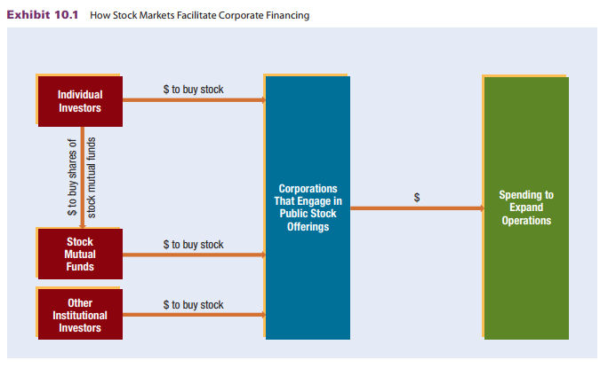
How Stock Markets Facilitate Corporate Financing
Source: Book by Jeff Madura

Slide 16
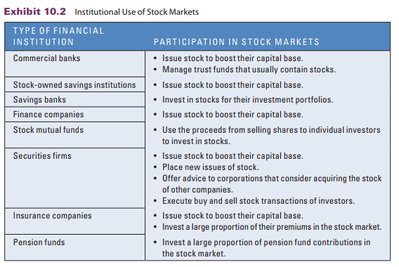
Institutional Use of Stock Markets
Source: Book by Jeff Madura

Slide 17
Secondary Market for Stocks
The secondary market creates liquidity for investors who invest in stocks. Many investors are willing to invest in stocks only because they can easily sell them at any time.
Buy undervalued shares and sell when the price rises.
Price discovery and liquidity are two major functions of secondary markets.
The price of a stock is influenced by the demand and supply of its shares. Positive news about a company's future performance increases demand, driving up the price. Conversely, negative news decreases demand and puts downward pressure on the price.

Slide 18
Globalization of Stock Markets
The globalization of stock markets has allowed companies to raise funds from international investors and investors to purchase foreign stocks. This has led to increased access to capital for firms and expanded investment opportunities for individuals.
Emerging stock markets offer opportunities for foreign firms to raise capital and for investors to seek higher returns. However, these markets often have regulatory challenges, limited financial information, and potential for manipulation. While they can offer high returns, they also come with increased risks due to their volatility and potential for insider trading.

Slide 19
Globalization of Stock Markets
Trading Activity: The volume of trading activity in a stock market is influenced by various factors, including shareholder rights, legal protection, government enforcement, corporate corruption, and financial reporting requirements.
Shareholder Protection: Countries with stronger shareholder protection tend to have more active and stable stock markets.
Transparency: Countries with stricter financial reporting requirements and less corporate corruption provide a more transparent and reliable environment for investors.

Slide 20
Methods Used to Invest in Foreign Stocks
Direct investment: Investing in foreign stocks can be done through local exchanges or brokerage firms. Returns for U.S. investors are influenced by currency exchange rates. A stronger foreign currency boosts returns, while a weaker one reduces them.
American Depository Receipts (ADRs): ADRs (American Depositary Receipts) are a way for U.S. investors to invest in foreign stocks. Many non-U.S. companies issue ADRs to gain visibility and raise capital in the U.S. There are over 2,000 ADRs trading on U.S. exchanges, representing companies from various countries. (IDR from Standard Chartered in India in 2010)
International Mutual Funds: Investing in international mutual funds (IMFs) is another way to invest in foreign stocks. These funds offer diversification across various countries and currencies. However, the returns on IMFs for U.S. investors can be influenced by currency exchange rate fluctuations.
International ETFs: Exchange-traded funds (ETFs) are passively managed funds that track a specific index. International ETFs provide exposure to foreign stock markets. They trade like stocks on exchanges and offer a way for investors to invest in a particular country's stock index.

